Slide 1
NA2 – The Physical and Data Link Layers
COMP 256 – Dickinson College
Prof. Braught
Spring 2023
Image from: https://dealna.com/Article/
Post/6564/Networking-Accessories

Slide 2
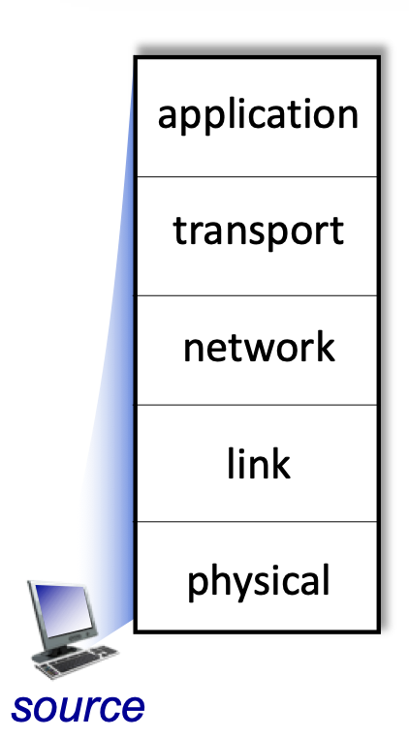
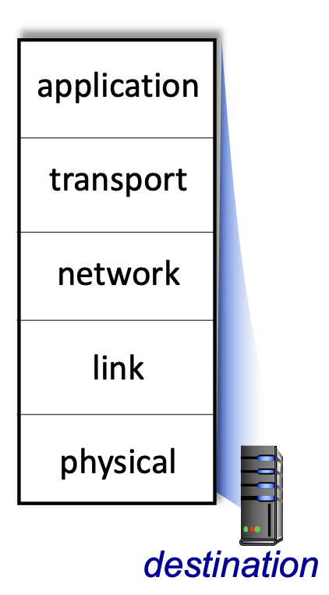
Bridging the Chasm: Network Layers
Getting information from one application to another.
Application Layer Service
HTTP
HTTP
TCP/
UDP
Transport Layer Services
TCP/
UDP
Source
Network Layer Services
Destination
IP
IP
Ether- net
Link Layer Services
Ether- net
Physical Layer Services
Wires
Wires
Image adapted from: http://gaia.cs.umass.edu/kurose_ross/videos/1/5/1.5_video_slides_posted.pptx

Slide 3
Network Data Encapsulation
Data
Data
Data
Data
Link Layer Info
Network Layer Info
Message
Transport Layer Info
Application
Layer Info

Slide 4
The Physical Layer

Slide 5
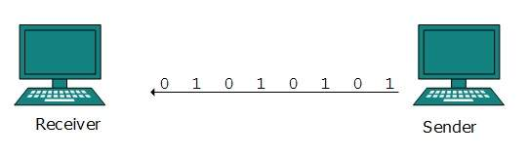
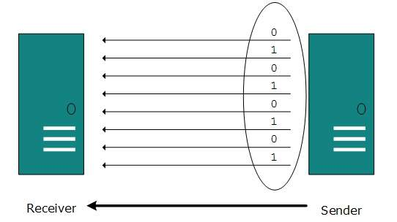
Physical Layer: Data Transmission
Physically transmits bits across a communication link.
Serial Transmission: Bits are sent and received one at a time, one after the other.
Parallel Transmission: Multiple bits are sent simultaneously on separate wires, fibers or channels.
Images from: https://www.tutorialspoint.com/data_communication_computer_network/digital_transmission.htm
Notes:
Most things we think about as networking use serial transmission.

Slide 6
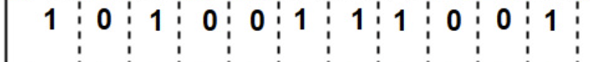
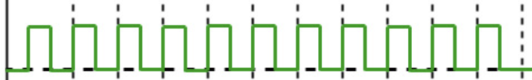
Physical Layer: Transmitting Bits
Clock
Cycle
Data
Source
Destination
Clock
Newest
Oldest
Rising Edge
Time
The source node transmits the Data bits at the rate of one per clock cycle
The destination node samples the signal at the rate determined by a clock (red arrows).
Samples typically occur on the rising edge of the clock.
Image adapted from: https://www.geeksforgeeks.org/manchester-encoding-in-computer-network/
Notes:
Whether we are transmitting serially or in parallel, each wire or communication channel transmits one bit.
Here we see a diagram of a source node transmitting bits to a destination node.
- The source’s network card contains an electronic clock (similar to the CPU clock)
- The speed at which this clock runs determines the rate at which the bits are sent.
- One bit is sent per clock cycle (like a tick of the clock).
- A cycle consist of the clock having a high low value for a period of time and then transitioning to a high value.
- Note time is running from right to left here.
- the 1 bit on the right was the one that was sent the longest ago.
Moving right to left:
- The source places the first data value (1) to be transmitted on the communication link
- It holds that value there for one clock cycle.
- during that time the destination will read the data from the link.
- Then at the start of the next clock cycle the source places the next value onto the link.
- And holds it there for one clock cycle.
- Again the destination reads that value from the link during the clock cycle.
- And so on, until all data has been transmitted.
Note that the destination must also have a clock to decide when to read the data from the link.
- Ideally, the destination will read the data right in the middle of the clock cycle.
- We call this reading - sampling – the data.
- So ”The destination samples the data in the middle of a clock cycle”
Sampling in the middle of a clock cycle helps to deal with some electrical engineering challenges that arise from transmitting signals across links.
- That is beyond the scope of this course.
- You may hear some about it in Computer Networks (COMP 352) but it is often an Signals and Systems course in electrical engineering.

Slide 7

Clock Synchronization
What could happen if the clocks are not synchronized?
The clocks on the sender and receiver must be synchronized – i.e. running at the same rate.
Image adapted from: https://www.geeksforgeeks.org/manchester-encoding-in-computer-network/
Notes:
Synchronized:
- Same rate – the ”rising and falling edges” of the clock on sender and receiver happen at the same time.
Here the clock at the destination (red arrows) is running just a little slower than the clock at the source.
- What happens?
It may seem like this is just a simple engineering problem…
but its actually pretty hard (impossible) to get clocks to run at exactly the same rate.
It’s easy to think about synchronizing clocks on human time scales
- Where a second or so difference doesn’t matter.
But at the speeds at which network communications operate it is actually a hard problem:
- For a bandwidth of 100Mbps we need to send 100,000,000 bits per second.
- So the clock cycle would be 1/100,000,000 seconds (1x10^-9 seconds = 1 ns) long.
- So here if the difference between the source and destination clocks is 0.1 ns
- then ~ every 10th bit would be read incorrectly.
- that would be unacceptable… so the synchronization has be be better than 0.1 ns.
To put some scale on that:
- imagine synchronizing your watch with a friend to within 0.1ns or 10^-10 seconds.
- it would take 10^10 seconds (~ 316 years) for your watches to be one second apart!
So the point is that the clocks need to highly synchronized and that is a hard problem.
- So instead, to make it easier, the clocks get resynchronized ofthen.
- We’ll see one way that this is handled in just a little when we discuss Ethernet in the data link layer.

Slide 8
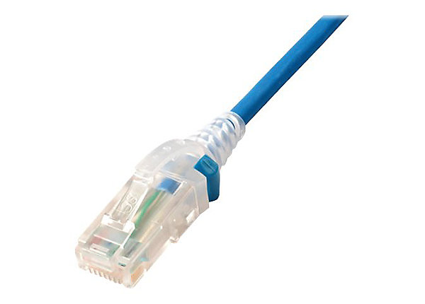
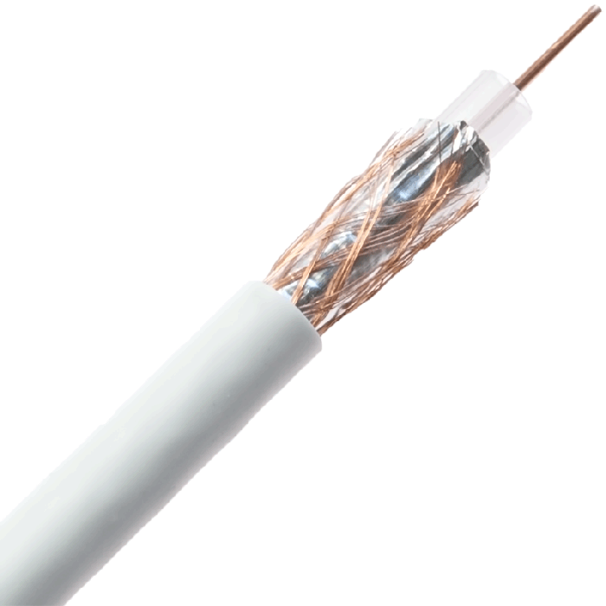
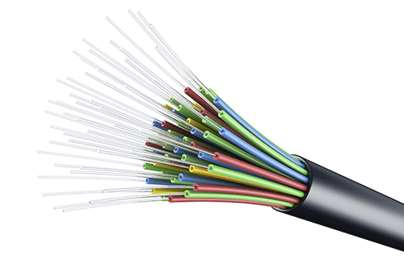
Physical Layer: Bandwidth
The bandwidth of a communication link is the maximum number of bits that can be reliably transferred per unit of time.
Determined by the clock speed which is limited by the physical medium and the connectors.
Twisted
Pair
Coaxial
Cable
Fiber Optic
Cable
WiFi
Cellular
100’s Mbps
per
channel
100 Mbps –
10 Gbps
10 Gbps –
100’s Gbps
100 Mbps –
1 Gbps
50 Mbps -
1 Gbps (5G)
Image adapted from: http://gaia.cs.umass.edu/kurose_ross/videos/1/2/1.2_video_slides_posted.pptx
Notes:
The design of physical medium and connectors are engineering disciplines all their own.
The Harrisburg area happens to have a lot of Connector design companies.
- In fact it is likely that many of the network connectors that you have used were designed very close to here.
- Many of my friends have made careers of designing connectors
- My wife included.

Slide 9
Data Rate vs Bandwidth
The data rate (or throughput) of a network is the number of bits of data that are actually transferred per unit of time.
The data rate is a property of the hosts, the network layers, the network interfaces and the bandwidth of the communication links.
Notes:
Notes:
- The physical layer is part of this, but it is not the entirety of it.
- Data rate does not include transmission of the overhead of packet header information that is added at each layer.
Also note:
- In marketing and general conversational used bandwidth and data rate (i.e. throughput) are used interchangeably.
- But technically they refer to different things.

Slide 10
Physical Layer Encodings
To transfer bits a network interface card (NIC) must encode the bits on a communication link.
For example, as electrical signals on wire(s), as light pulses through a fiber optic cable, or on radio waves in the air.

Slide 11
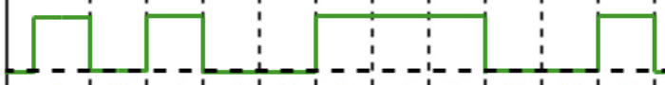
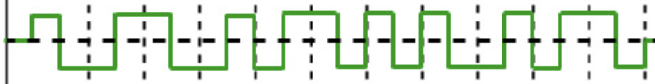
Some Physical Layer Encodings for Wires
Data
Non-Return
To Zero (NRZ)
Source
Manchester
Destination
Clock
Newest
Oldest
Time
Image adapted from: https://book.systemsapproach.org/direct/encoding.html
Notes:
There are different ways to encode the 1’s and 0’s into electrical signals on the wires.
NRZ: Non-Return To Zero
- 0’s are encoded as a low voltage near ground
- 1’s are encoded as a sufficiently positive voltage that is differentiable from ground.
Manchester Encoding:
- 1’s are encoded as a transition from ground to a positive voltage at the rising edge of the clock.
- Remember we read from right to left.
- For example, the right most 1 is the rising edge of the cock corresponds to the rising edge of the data.
- 0’s are encoded as a transition from a positive voltage to ground at the rising edge of the clock
Note: Ethernet uses Inverted Manchester Encoding.
- Just switch which transition represents 0’s and 1’s.

Slide 12
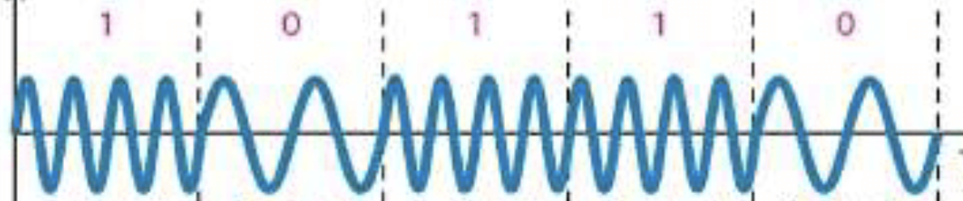
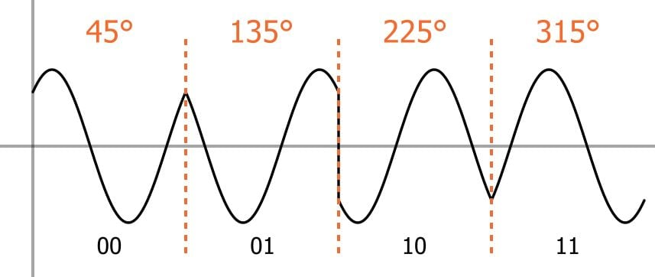
Some Physical Layer Encodings for WiFi/Radio
Frequency
Shift Keying
Encoding
Destination
Source
Newest
Oldest
Time
Image adapted from: https://www.researchgate.net/figure/Frequency-Shift-Keying-FSK-signal-5_fig6_309595949
Quadrature
Phase Shift
Keying
Image from: https://www.allaboutcircuits.com/technical-articles/quadrature-phase-shift-keying-qpsk-modulation/
Notes:
Notice that Quadrature Phase Shift Keying is able to transmit multiple bits at a time (lightly parallel).
- But if the time intervals are equal this would double the bandwidth of the medium

Slide 13
The Data Link Layer

Slide 14
The (Data) Link Layer
Network interface cards add/understand extra information to pass messages between two or more neighboring nodes.
Ethernet
Notes:
There are many Data Link Layer technologies
- We will look at Ethernet
- It is by far the most widely use and has some interesting ideas.

Slide 15
Ethernet uses a Broadcast Medium
Ethernet frames (packets/messages) are broadcast* to all nodes on the local area network.
Each network interface card (NIC) has a unique 6-byte physical (MAC) address.
A node will only processes frames that are addressed to it.
Image adapted from: http://gaia.cs.umass.edu/kurose_ross/videos/6/4/6.4_video_slides.pptx
Notes:
Messages in ethernet are called Frames.
Because frames are broadcast
- Every network interface card will receive every frame.
- However, nodes do not process every frame their card receives.
- They simply ignore frames that are not addressed to them.
- Frames that are addressed to them are then handed up to the next higher layer of abstraction.
MAC: Media Access Control
- Basically this is the Ethernet Interface Card in your computer.
* Technical Detail: Ethernet was designed to work over a broadcast medium.
- However, many more modern ethernet LANs typically use switching instead of broadcast.

Slide 16
Ethernet Message (Frame) Format
type
preamble
dest.
address
source
address
data (payload)
CRC
(8 bytes)
(6 bytes)
(6 bytes)
(2)
(64 – 1500 bytes)
(4 bytes)
preamble: 7 bytes of 1010 1010 and one byte of 1010 1011
source address: MAC address of node sending the frame.
dest. address: MAC address of node to receive the frame.
type: Information about size* of the payload.
payload: The bits of data being sent.
CRC: Cyclic Redundancy Check for detecting bit errors in transmission.
Image adapted from: http://gaia.cs.umass.edu/kurose_ross/videos/6/4/6.4_video_slides.pptx
Notes:
When an Ethernet data link layer is handed a packet of information to transmit it wraps it in a frame.
- The frame is where the Ethernet layer adds its additional information.
- Slightly different representation than our earlier diagram (in the upper right)
- This format is intended to represent a string of bytes and is commonly used in networking specifications and documentation.
Preamble: Why might that specific set of bytes be transmitted during the preamble?
- Note some sources differentiate the last byte of the preamble (10101011) as the Start Frame Delimiter (SFD)
- It just indicates the end of the preamble and the start of the frame information.
Dest / Source Address: These are the MAC addresses of the source (sending) node and the recipient (destination) machine for the message.
Type: If this value is 64-1500 it indicates the number of bytes in the payload.
- Values other than 64-1500 have been assigned specialized meanings that allow different types of optimization.
- We won’t be discussing those.
Payload: This is the data handed off to the Data Link Layer by the Network layer.
- We know that the actual data we want to send is wrapped inside of other layers added by the network, transport and application layers, but it is buried in there
CRC – a Cyclic Redundancy Check.
- These are additional bits that are computed based on the rest of the frame (excluding the preamble).
- They are computed in such a way that if typical bit errors occur during transmission they can be detected.
- That is if bits are flipped from 0 to 1 or 1 to 0 the destination will be able to tell.
- This value is typically computed by special purpose hardware on the network card.

Slide 17
Ethernet uses a broadcast medium… what could go wrong?
How might we deal with it?
Notes:
Conversation Analogy.
- Imagine sitting around a table with friends or family…
- The air in the room is like a broadcast medium
- It is carrying everyone’s voices
What happens when two people start speaking at the same time?
How are those situations typically handled?
If we were to try to formalize that process how might we write it down?
- this type of formal process for interacting is called a protocol.
- we’ll talk more about that at the higher layers.
We’ll do the same thing with Ethernet!

Slide 18
The Ethernet Protocol: Source
When transmitting data an Ethernet source uses Carrier Sense Multi-Access with Collision Detection (CSMA/CD) :
Listen, if no other node is transmitting, start sending the frame, otherwise wait until clear.
Monitor, if one or more other node begin transmitting at the same time (a collision occurs), stop transmitting.
Wait, if a collision occurred, wait a random amount of time and go to step 1.
Carrier
Sense
Collision
Detection
Notes:
This is a three part process:
First, the source will “listen”
- It checks the transmission medium to see if any other node is currently are transmitting.
- That is the “carrier sense”
- The transmission medium is the “carrier” of the signals.
- The source is “sensing” it to see if another node is transmitting.
- If no other node is transmitting, the source will begin to send the data
- if another node is transmitting the source will wait until no other node is transmitting
- Then it will begin sending its frame.
Second, when the source is transmitting it will monitor the transmission medium
- If it detects that one or more other nodes have also started transmitting at the same time
- This is called a collision
- When a collision occurs, all nodes that detect it will stop transmitting.
- This makes sense, because once a collision occurs, the data being transmitted will be corrupted.
- e.g. one note transmits a 0 and another transmits a 1… the result will not be recognized as either.
- The voltage or frequency on the carrier will be somewhere in between (neither a 0 nor a 1).
- Note that if one node detects a collision, all nodes in the collision stop transmitting.
Third, if a node detected a collision, it will wait a random amount of time and then try again.
- Note again, that all nodes in the collision will be doing the same thing.

Slide 19
Ethernet Collisions: How long to wait?
Exponential Backoff
n = number of collisions in a row
Pick k = random(0, max)
with max = min(2^{n}, 2¹⁰)
Wait k*512 clock ticks
Try again
What is the largest number of clock ticks a node would
wait on the:
1st Collision?
5th Collision?
12th Collision?
Notes:
Each node that is involved in the collision picks a different random amount of time to wait.
- If they waited the same amount of time there would likely just be another collision.
The time that each node waits is determined using what is known as “Exponential Backoff”
- Each node keeps track of how many collisions it has had in trying to send the message (n)
- It uses that n to pick a random number (k)
- The range of possible values for k depends on n.
- This range grows exponentially (2¹, 2², 2³, etc.)
- The node then waits k * 512 clock ticks
- I.e. the time it would take to send k*512 bits.
- It then goes back to listening/sensing the medium to see if it is available.
- if so it transmits… etc…
Assuming here that random(0, max) picks a value between 0 and max-1 inclusive.

Slide 20
The Ethernet Protocol: Destination
When receiving data, an Ethernet destination node will:
Compute: recompute the CRC value based on the frame as it was received.
Compare: compare the recomputed CRC value to the CRC value that was computed and transmitted by the sender.
Handle: if the CRCs do not match, the frame is silently discarded, otherwise hand data off to the network layer service.
Unreliable
Delivery
Notes:
When a destination receives a frame that is addressed to it:
First, it uses the information in the frame it received to compute the CRC value
- Note that the information received may be different than what was transmitted if an error occurred in transmission.
Second, the sender compares the CRC that it computed to the one that was received.
Third, it handles the frame:
- if the CRC’s do not match then it is very likely that an error occurred during transmission.
- The node simply discards that frame.
- It does this silently, without telling the sender in any way.
- Seems rude…
- But remember, at this level the destination didn’t ask for this frame, the sender just broadcast it.
- These two machines are not trying to talk to each other…
- They are just relaying the data along the way…
- Reliable delivery will be provided by a higher layer service between end nodes that intend to talk to each other.
- E.g. Between a web browser and a web server.
- If the CRC’s match then it is very very unlikely that an error occurred during transmission.
- so the data part of the frame is handed off to the Network layer which will process it.
- A router will just look at it to see where to send it next.
- An end node will pass it on up to the transport and application layers for processing.

Slide 21
Error Detection and Correction

Slide 22
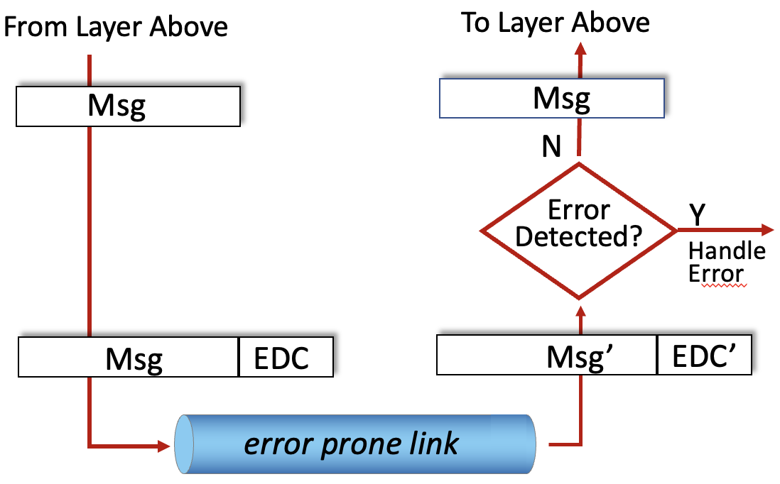
Error Detection and/or Correction
Error detection and/or correction bits (EDC) are often added at the Data Link, Network and Transport layers.
Ethernet uses Cyclic Redundancy Check (CRC).
Others are:
Parity bits
Internet Checksum
Hamming Codes
Image adapted from: http://gaia.cs.umass.edu/kurose_ross/videos/6/2/6.2_video_slides.pptx
Notes:
Communications links are prone to errors:
- bits get flipped from 0’s to 1’s or vice versa as they move across the media.
- Noise in circuits as components generate and dissipate heat.
- External noise from other sources
- E.g. power lines, motors, atmospheric conditions
- these are the hums, buzzes, clicks and pops that you hear on calls.
- Signal distortion as the electrical, optical, or radio signals travel through the media.
- You may send a very square signal, but as it travels over the wire the properties of the wire distort it.
- It arrives at the other end rounded off.
Because these types of errors are an unavoidable part of communication systems include ways to detect and correct them.
The way this works:
- The sender will add additional bits to a message.
- These bits are computed to allow errors to be detected and/or corrected.
- The original message plus the additional bits are send to the destination.
- the destination then uses the additional bits to detect and/or correct errors.
In Ethernet the CRC value is used as was described.
- If an error is detected then the message is just discarded.
- In some other systems, the error may be corrected and then the message processed just like it had been received correctly.

Slide 23
Parity Bit
Which of the following even parity values contains a transmission error?
1001 0101 0
0111 0111 1
1011 1001 1
A parity bit is an extra bit appended to a piece of data (typically each byte) to detect errors in transmission.
Even Parity – the parity bit is chosen so that the data + parity bit has an even number of 1’s.
Odd Parity can also be used.
What odd parity bit would be added to the following bytes before transmission?
1001 0101 __
0111 0111 __
1011 1001 __
Notes:
A parity bit is one of the simpler types of error detection that can be done.
You’ll get some more experience with parity and see how it can be extended to do error correction in the homework.
The homework also gives some resources and optional exercises with some other EDC techniques:
- Internet Checksum
- Cyclic Redundancy Check

Slide 24


Acknowledgments
Slide Template From:
https://creativecommons.org/licenses/by/4.0/
Slide Content Licensed as:
Creative Commons Attribution-NonCommercial-ShareAlike 4.0 International License.
Notes:
Note: Individual images may be covered by their own licensing agreements and were incorporated here under fair use. Their use in this slide deck does not change or alter their licensing.

Slide 25
Some Physical Layer Encodings for Optical
Notes:
Maybe add in the future…

Slide 26
Internet Checksum

Slide 27
Switching vs. Broadcast

Slide 28
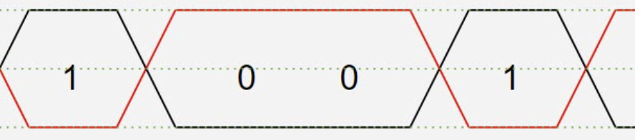
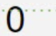
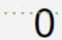
Physical Layer Transmission: Wired
Wired networks use different media, but one common one Twisted (differential) Pair.
+V_{ss}
Differential
Pair Media
-V_{ss}
Clock
Image adapted from: https://www.microcontrollertips.com/what-is-differential-signaling-faq/

Slide 29
Network Protocols

Slide 30
Network Protocols
Used for communication between source and destination within a layer
Application (HTTP, SMTP, …)
Transport (TCP/UDP)
network layer (IP)
link layer (ethernet)
Physical layer (encodings)

